Slide 1
Hair we go again!
Negotiating space and diasporan identity
Vera Williams Tetteh
Macquarie University
Supervisor: Prof Ingrid Piller
Associate supervisor: Dr Kimie Takahashi
Workshop: Linguistic Diversity and Social Inclusion in Australia
Macquarie University,12 October 2012

Slide 2
Objectives
The paper discusses how African hairdressers and consumers of African hair-styles carve spaces for multilingualism and for local and global identities. The paper argues that such ‘minor’ discourse practices:
create inclusive spaces in a linguistically and culturally diverse society
provide great insights into power relationships that mediate diasporan identities
illuminate the interplay between language ideologies and language use in migrant settlement processes

Slide 3
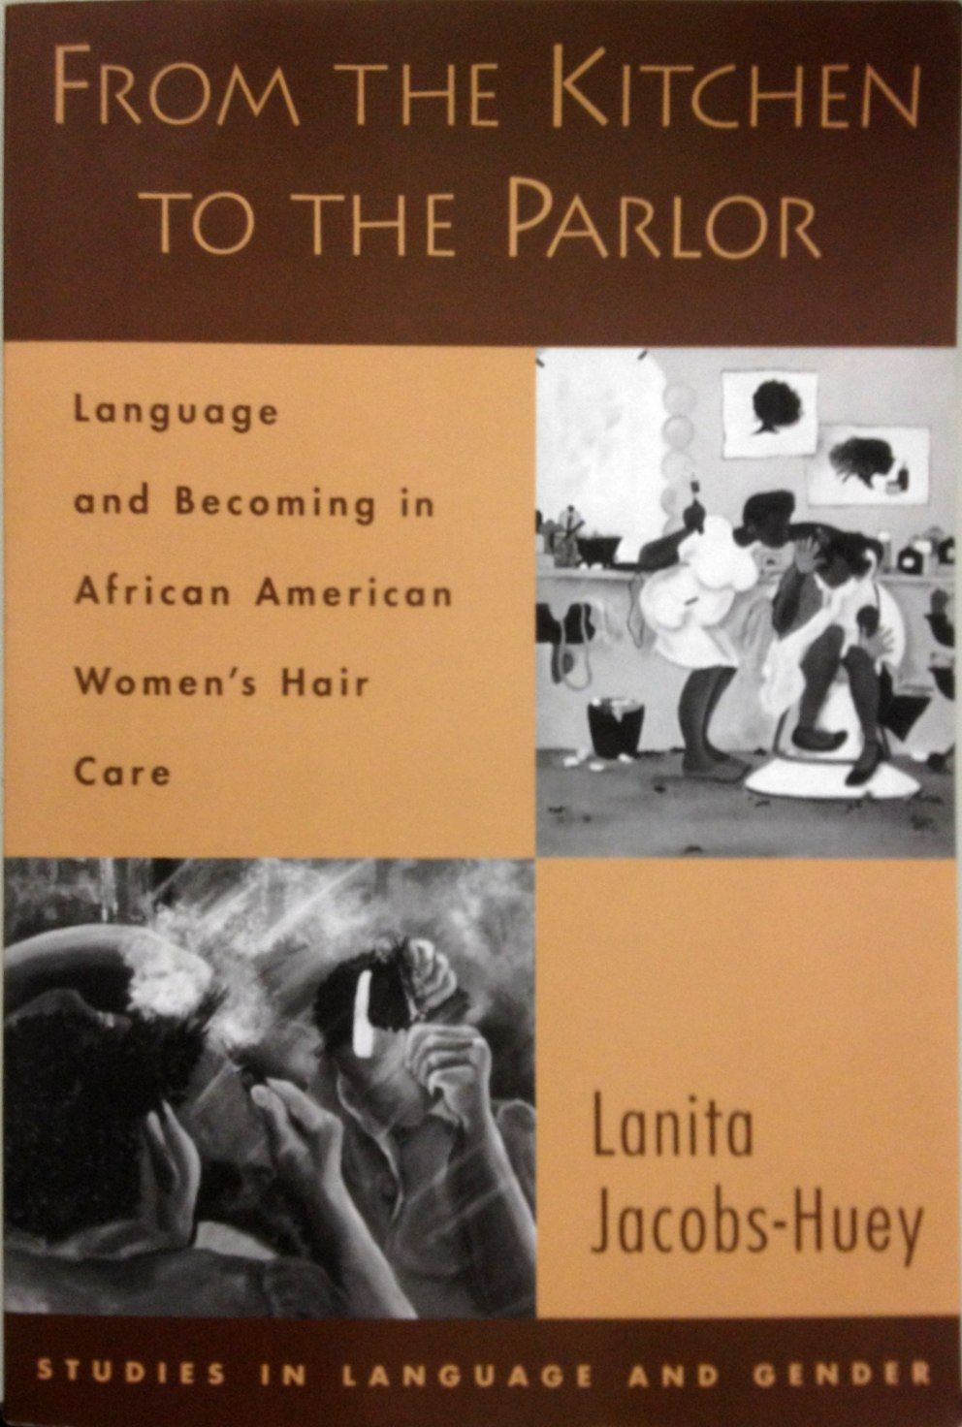
Literature on Black Women’s Hair Discourses

Slide 4
Research Question
How do participants negotiate identity for settlement?
This question addresses (counter)discourses of racialized and gendered identities at three levels:
Individual and family
Cultural - community and networking
Social - Employment
Notes:
The RQ comes from one of four my broader research questions

Slide 5
Methodology
A sociolinguistic ethnography
Data site
An African Hairdressing Salon in Sydney
Participant observation (beginning in January 2008)
Fieldnotes
Data Analysis
Three levels
Individual agency
Cultural norms and values
Structural constraints

Slide 6
African Hair Salons in Sydney Suburbs
Auburn (2)
Bankstown (3)
Bexley (1)
Blacktown (4)
Burwood (1)
Campsie (1)
Campbelltown (2)
Croydon (1)
Enmore (2)
Fairfield (2)
Guildford (1)
Hurstville (1)
Lakemba (2)
Liverpool (3)
Marrickville (1)
Merrylands (5)
Mount Druitt (2)
Newtown (1)
Parramatta (5)
Penrith (3)
St. Marys (1)
Notes:
Hair dressing locations

Slide 7
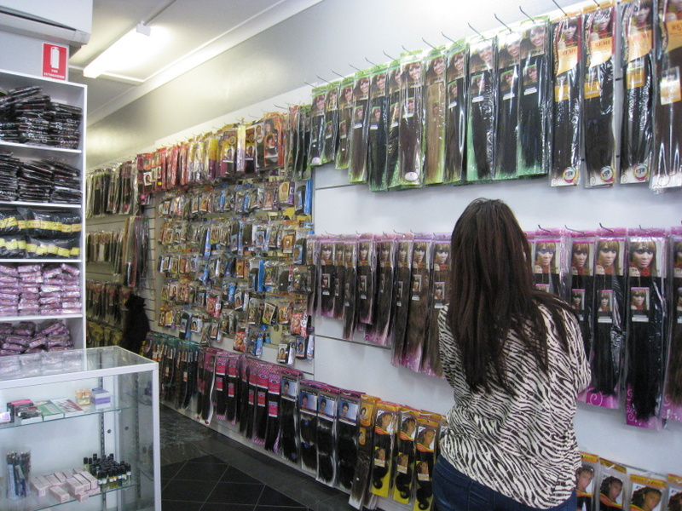
Creating Inclusive Space
Insert image from salon
Before this shop was not here. I used to do my hair at home. Now I come to do retouch (straightening) every six weeks. (Woman with perm)

Slide 8
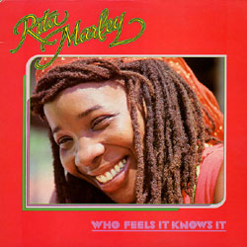
Hair and Identity Discourses
Hair discourse 1
When I started doing dreadlocks our people did not like it. They said how can a mother do such a hair style? But I did not listen to them. Now I have hair just like Rita Marley. I can swing my hair see? (Woman with locks)
Hair discourse 2
My friend [African] said to me, “why this style? You will not get a job in an office with that.” (Woman with locks)
Take pride in your appearance. Tone the African down then when accepted you can blow it up. Don’t shock them with your African appearance (Young African woman’s advice on how to present at interviews)
Source: http://www.google.com.au/imgres

Slide 9
Racialized Identities and Power Asymmetries
Oh my when I go they will be saying, “oh your hair looks good. Did you do it yourself? How long did it take? Is it your real hair? Can I touch it”? And when they start I will be going backwards because some of them by the time you realise they are touching your hair. (Woman with braids)
Source: http://provenhair.wordpress.com/2011/05/31/braiding-style-ideas-braids-hairstyle-pictures/

Slide 10
Summing up
African women’s hair styles as discourse practices provide insights into exploring:
Niches of belonging and a sense of connectedness with other local, continental and international black African people
‘Invisible’ African (hair) discourses in the linguistic landscape
Visibility and micro inequality grounded in African women’s racialised and gendered identities

Slide 11
Hair we go again!
Negotiating space and diasporan identity
Vera Williams Tetteh
verawilliams.tetteh@gmail.com
Notes:
Thank you!

