Slide 1
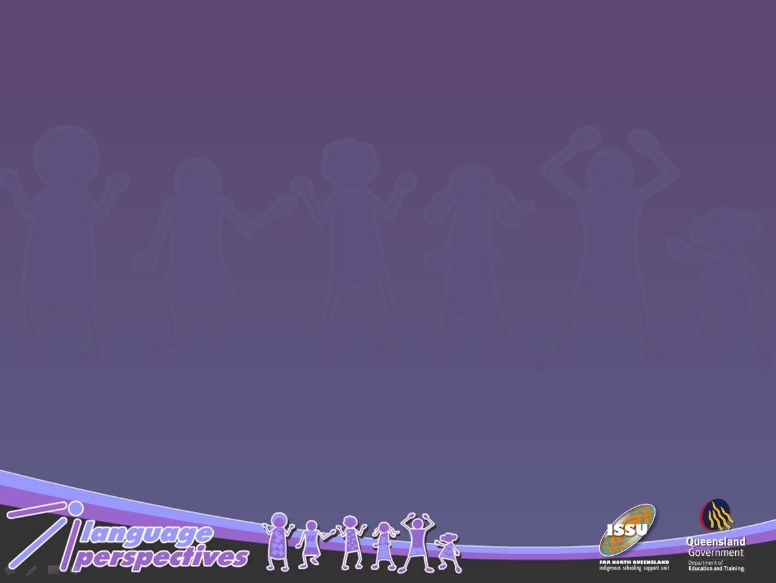
Dodgy data, language invisibility and the implications for social inclusion: a critical analysis of student language data in the Queensland Education system.
Denise Angelo & Sally Dixon

Slide 2
“Bridging the Language Gap”
AIM: to build capacity in Queensland schools for identifying, supporting and monitoring Indigenous students who are learning Standard Australian English (SAE).
Around 90 participating schools across QLD with a ‘Language Leader’ in each school

Slide 3
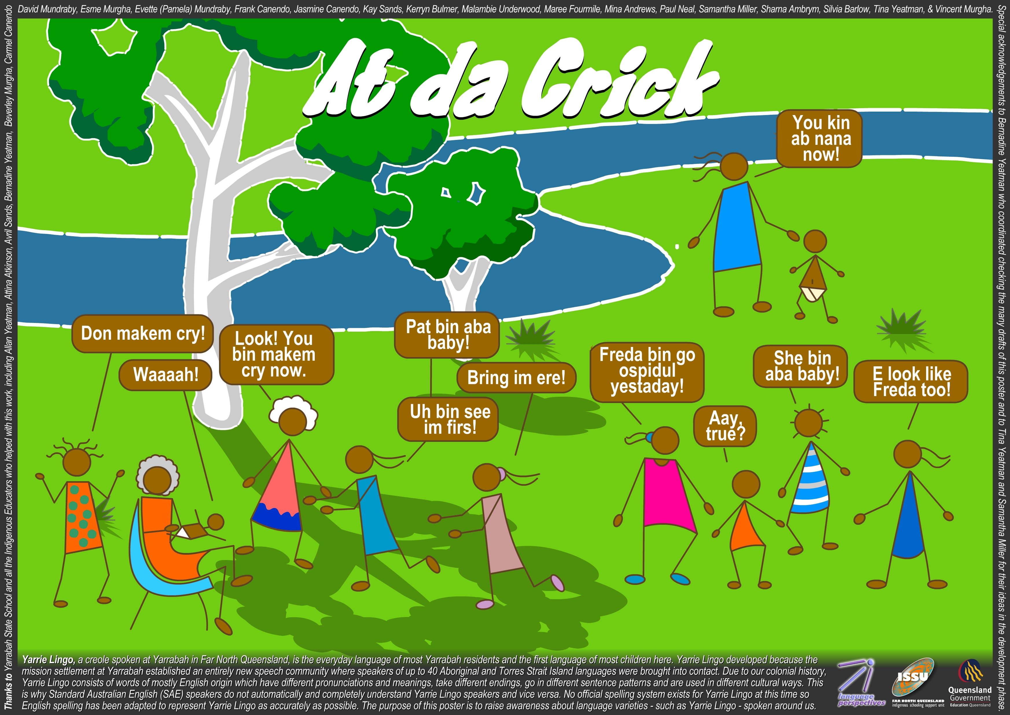
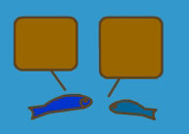
Yarrie Lingo
Torres Strait Creole
No go dat wei! I gat beit deya!
Wa, i gat prapa bi-i-ig uk deya!
Kam diswei!

Slide 4
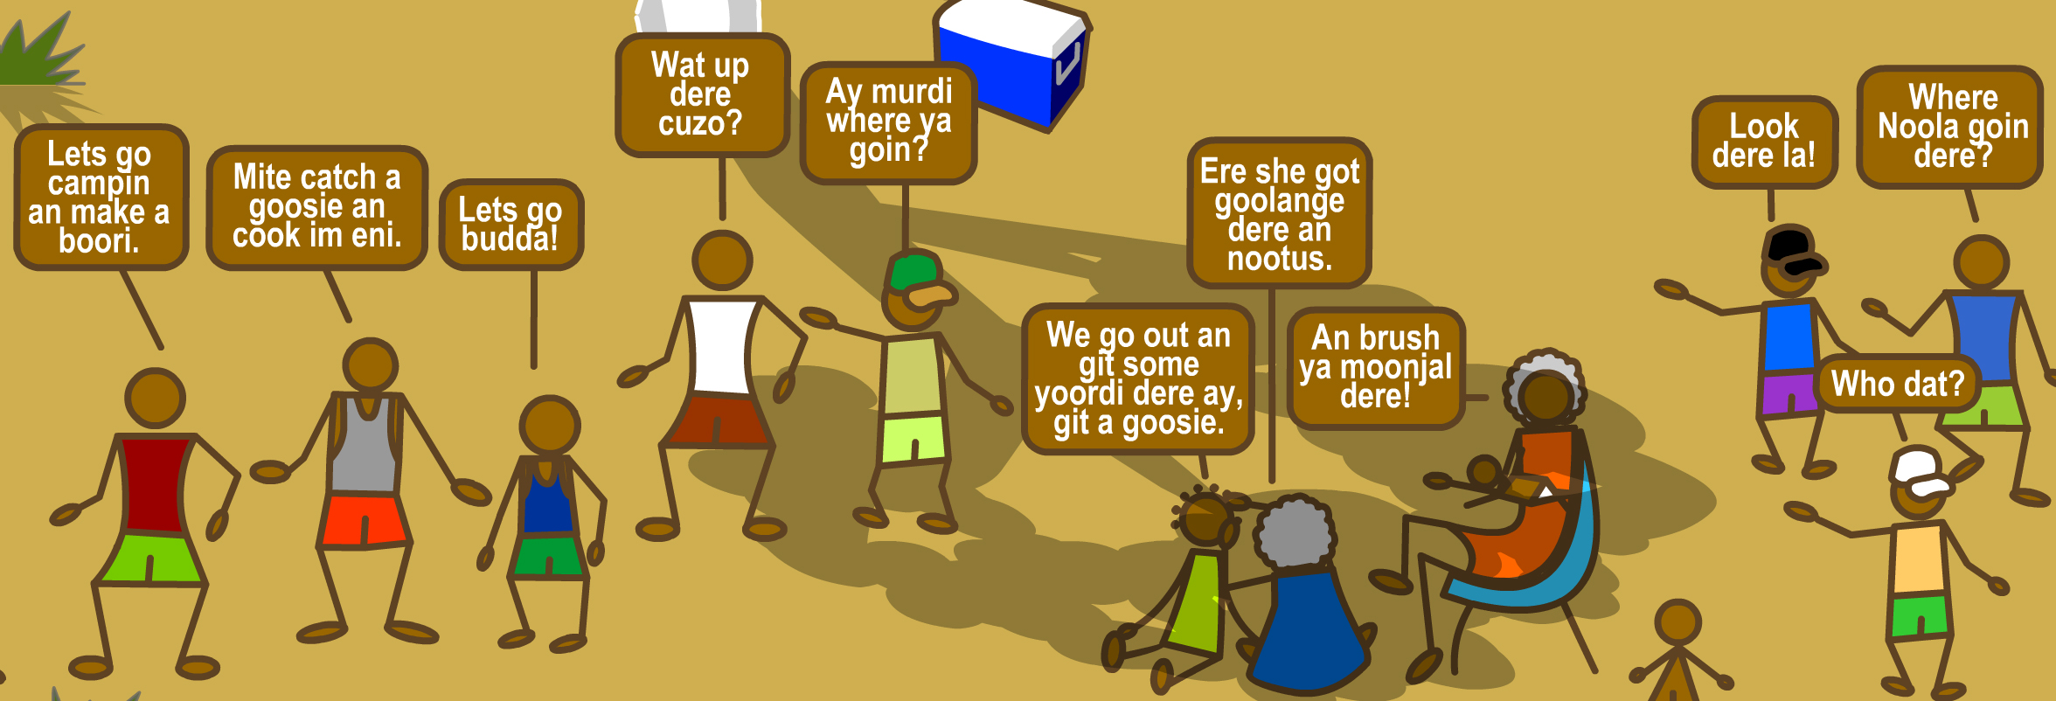
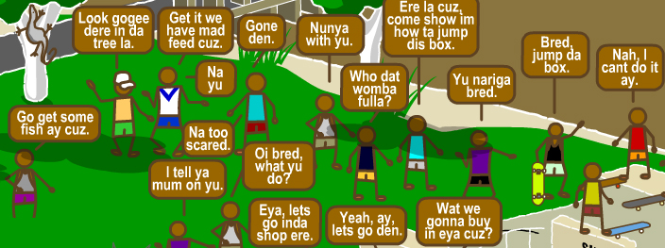
Murdi Language

Slide 5
How visible are our target students in the QLD education system?
Are particular types of languages more/less visible? Why?
What are the implications for acknowledging the ESL/D status of our students?

Slide 6
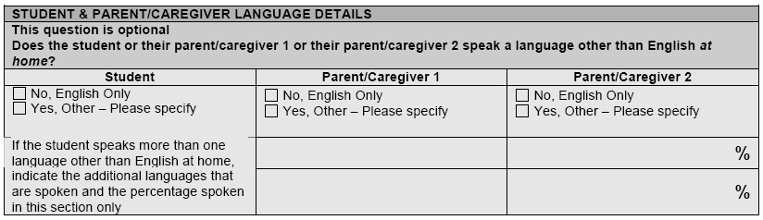
Enrolment data
‘Main Language Other Than English’ (MLOTE)

Slide 7
SAE Proficiency Data
‘English as a Second Language’ (ESL)

Slide 8
Language Background Other Than English (LBOTE)
“either the student or parents/guardians speaks a language other than English at home”. ACARA, 2011 p. vi

Slide 9
Enrolment data
‘Main Language Other Than English’ (MLOTE)
2 schools had accurate information
Indigenous students much less likely to have accurate MLOTE than overseas-born students
Torres Strait Creole has higher visibility than mainland creoles
Traditional languages visible in the Cape
Aboriginal English varieties, and various mainland creoles least visible across the state

Slide 10
SAE Proficiency Data
‘English as a Second Language’ (ESL)
Only three LLs felt the school had accurate ESL/D stats. In many cases data was even inaccurate in schools with active ESL programs targeting Indigenous students.
Indigenous students were far less likely than overseas-born students to have their status as ESL/D learners recognised and recorded in the system.

Slide 11
Language Background Other Than English (LBOTE)
LBOTE data was as inaccurate as MLOTE/ESL.
Most schools under-reported the number of Indigenous LBOTE students.

Slide 12
Why?
The ‘monolingual mindset’ and the missing pieces of knowledge about language and languages that this entails.
The high stakes environment created by the national standardised testing program sidelines the explicit teaching of English and recognition of other languages
The availability of a compelling and competing narrative > ‘poverty languages’ & ‘low socio-economic’ behaviours

Slide 13
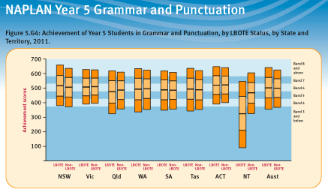

Slide 14
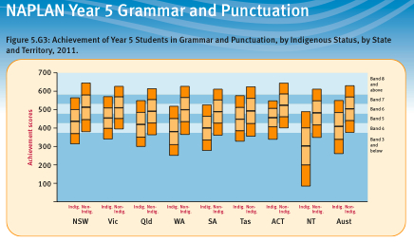

Slide 15
Language Background Other Than English (LBOTE)
“either the student or parents/guardians speaks a language other than English at home”. ACARA, 2011 p. vi

Slide 16
Whose gap?
Indigenous kids NAPLAN scores
Non-Indigenous kids NAPLAN scores
Indigenous kids’ current language repertoires
Indigenous kids’ current language repertoires
+PLUS SAE

Slide 17
Whose gap?
Multilingual students
ESL/D-learning Indigenous students
Monolingual, non-Indigenous students

Slide 18

3 way strong
Recognise
the language varieties
which Aboriginal and Torres Strait Islander
children, families and communities
are using for their “everyday” talk
Engage
Aboriginal and Torres Strait Islander students
in learning and achieving in schools
by teaching Standard Australian English
explicitly, actively and meaningfully
Support
Aboriginal and Torres Strait Islander children’s
rights to their traditional heritage
by maintaining, learning or researching
their traditional languages and cultures

Slide 19
Advice from the Teaching and Learning Branch’s ‘ESL in the classroom’ website:
Language codes developed by the Australian Bureau of Statistics
Schools enter MLOTE and LBOTE information via numerical codes derived from the Australian Bureau of Statistics (ABS). This may be quite difficult to determine for Aboriginal creoles and related varieties in Queensland.
The terms used by Aboriginal and Torres Strait Islander families to describe their languages (for example, Broken, Murri and Slang) are generally not included in ABS language codes. In this case, terminology used by the family should be noted and the following codes used (in One School):
8403 - Torres Strait Creole (which might be referred to as Yumpla Tok or Broken)
8300 - Cape York Peninsula Languages, nfd (not further defined) (including Cape York creoles which might be referred to as Lockhart, Kowanyama or Broken)
8000 - Australian Indigenous languages, nfd, (including other creoles which might be referred to as Lingo, Murri, Broken or Slang)
8998 - Aboriginal English, so described (including various dialects).

Slide 20
