Slide 1


The Japanese Story:
Struggling for Recognition in Australia
Human Sciences Perspectives in
Linguistic Diversity & Social Inclusion in Australia
高橋 君江
Kimie Takahashi, PhD
Assumption University of Thailand

Slide 2
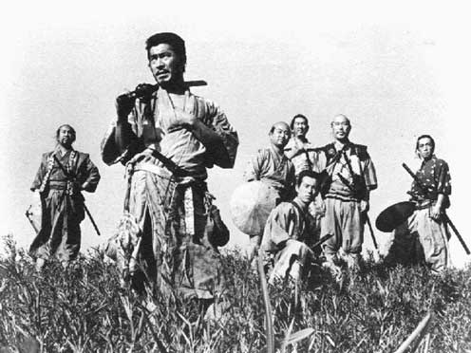
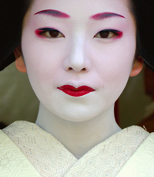
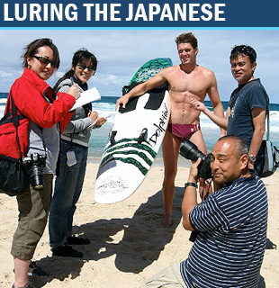
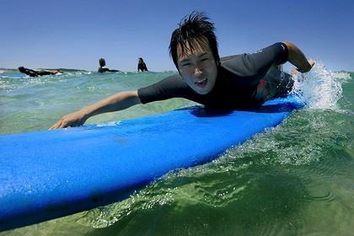


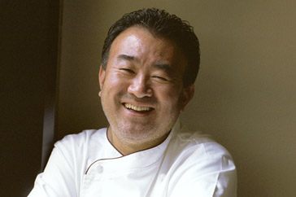

Japanese in Australian Media
Notes:
Presented as living in Australia: Three types of images, either they are tourists, who speak little English, taking photos and getting lost in the country side and kangaroos. Or they are students, who are represented as having problems because they can’t speak English or understand ; Or they are extremely successful representative, like Tetsuya Wakuda.
However, surely there are lots of Japanese normal regular people living in Australia. My long time colleague Ingrid Piller and I have been conducting research with Japanese people in Australia for quite some time now. We recently conducted a project, which is entitled “Japanese on the Move”, which was interested in the real life experiences of Japanese people living in Australia or of transnational migrants with connections to Japan and Australia. We specifically wanted to find out how they position themselves vis-à-vis the essentialist media discourses that I just introduced to you earlier.

Slide 3
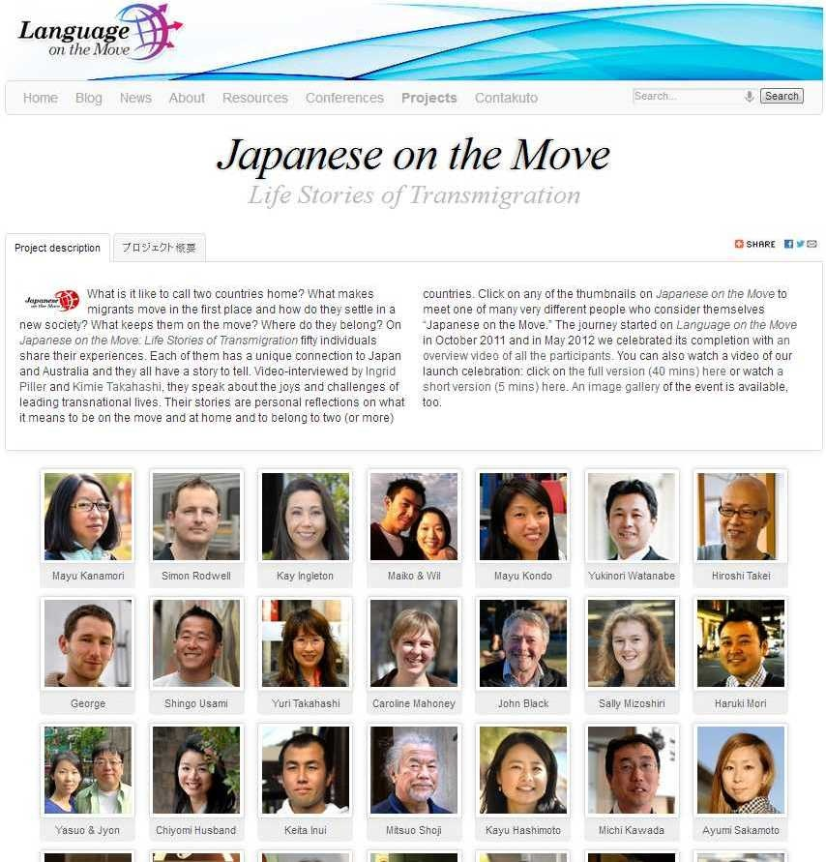
Japanese on the Move
Project:
  Online video exhibition on Language on the Move
  50 life stories of transnationals with ties to Japan and Australia
Aims:
  To showcase their lived experience of language learning, employment, family practice and sense of belonging
Funded by:
  The Australia-Japan Foundation (Ministry of Foreign Affairs and Trade) 2011 – 2012
Notes:
How they are struggling against the way they are conceptualised, one of the goals are to see how they lived their lives in Australia and Japan, and examples my argument is that challenging stereotypes is a key issue for all of them, it happens at all levels from Ambassador in terms of presenting competent identity and struggling for recognition as a competent speaker to everyday people and translating into how successful they can be, it’s not only stereotypes that they are struggling, but the path ways that; High IELTS levels; not:: how do real life Japanese people deal with the problem of essentialism
The research I’m going to present to you now asks how do ‘normal’ Japanese living in Australia, position themselves vis-à-vis those essentialist media discourses and how they experience life here while they are stereotyped in a particular way.

Slide 4
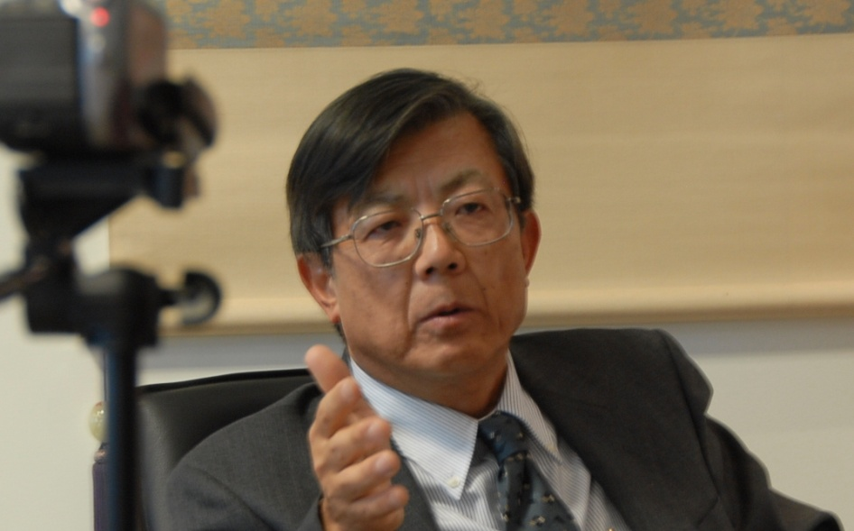
Struggling for Recognition
“The Real Ambassadors”
Over 70,000 Japanese nationals residing in Australia
The 3rd largest no. after the US and China
“The Burden of English”
English speaking people…do not understand what a heavy burden it is for the Japanese to learn languages, particularly English.
I feel 50% less intelligent
when I speak English.
Mr. Shigekazu Sato
Ambassador of Japan to Australia
(1:53 – 3:58)
Notes:
One thing we find struggle for recognition. This is exemplified by the Japanese ambassador; how English is burden for Japanese. Hard for him to express himself and have his status recognised in English; he states the challenge;

Slide 5
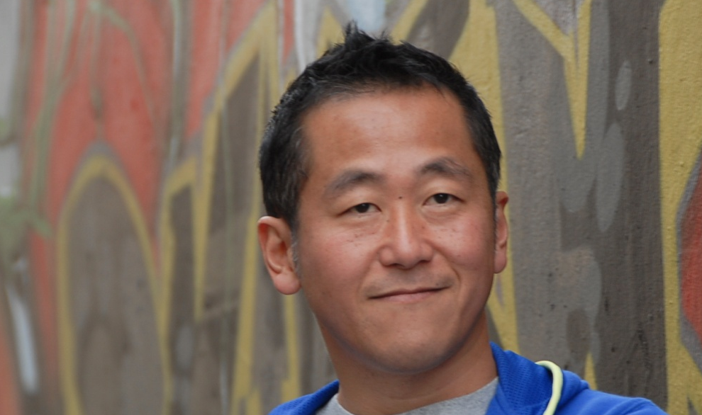
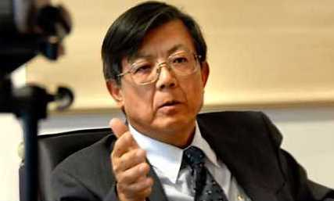
Challenging the Stereotypes
Making it in Showbiz
‘Japanese accent’
Native vs. non-Native
Australian-born vs. Japanese
Going beyond Japanese
I used to think that no matter how hard I might work, I would never reach the same level as them.
… I have access to two different cultures, and it’s a great advantage to be able to capitalise on both… I should give myself more credit for it
Shingo Usami, Actor
Arrival in 1995
(1:25 – 2:59)
Notes:
How people are heard the issue of accent relative to the example of Shingo – he speaks of roles he can get as an actor in Australia. How stereotypical roles;
Stating the challenge but also accepting the fact that you have unique resources. Australian ; go beyond

Slide 6
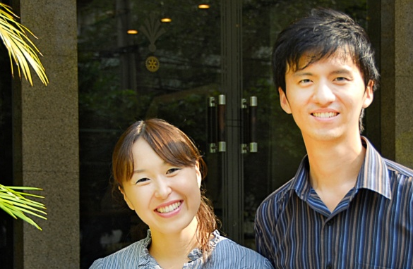
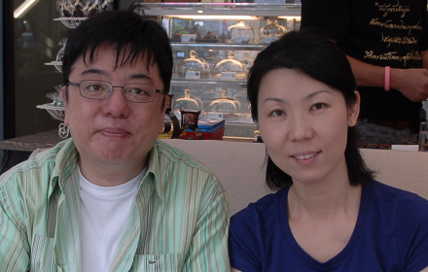
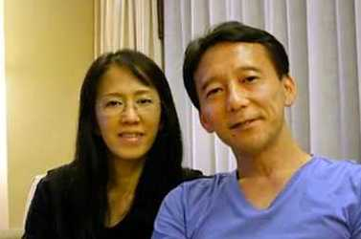
Re-imagining
Transnational Relocation as a Strategy
Escaping linguistic and racial discrimination in Australia
They want to recruit more Australians first. And then if there is a space left, they will recruit Asians, you know, non-native English speakers…
Why not just come back and try to find things to do here because…Thai organisations and companies look for people who have been educated overseas.
Kyoko Miyata, Service Manager
Ratchawit Soontornvinetr, IT Specialist (1:54 – 3:58)
Notes:
They are not facing they are not deficient speakers of English but, they are multilingual their these are successful people but they also decided to ; they can’t be bothered, fighting for essentialist representations in Australia, t
hey can put themselves in a couyr
Shingo reimagining himself as a bicultural in Australia;
Re-imagining themselves in a new country where they can position themselves as valuable and etc

Slide 7
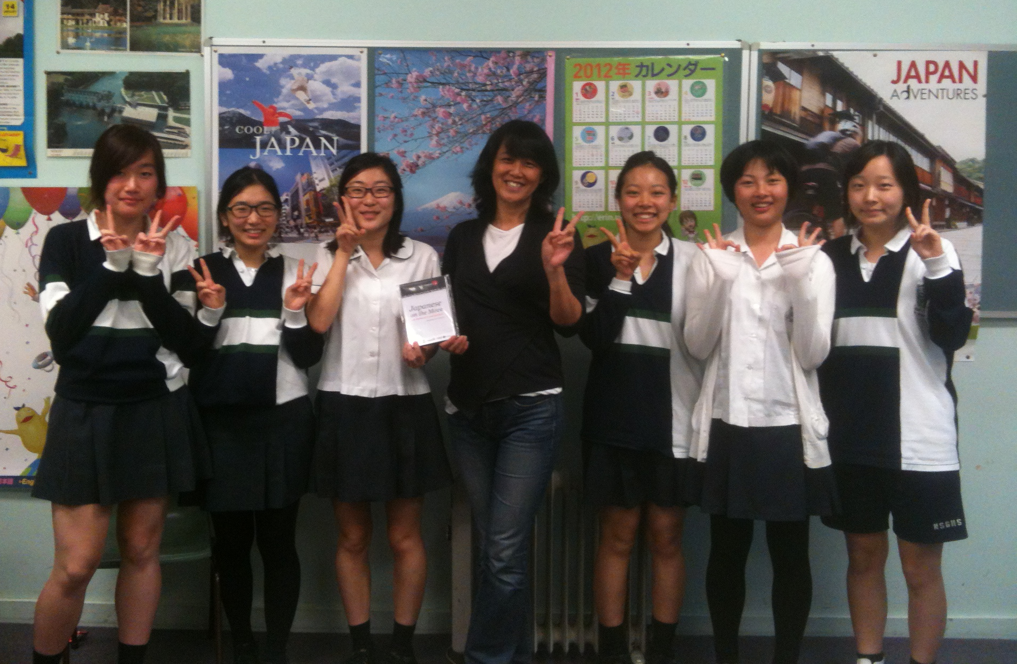
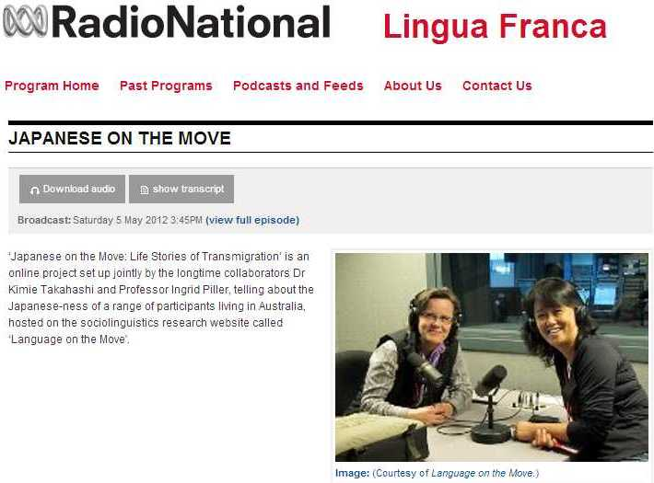
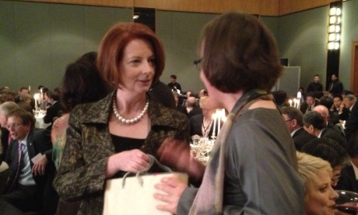
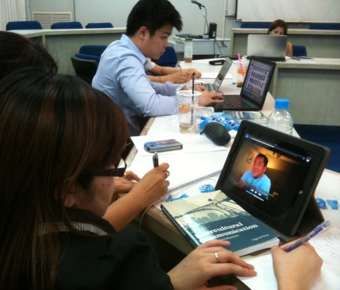

Continuing the Japanese Story
The Launch
  Faculty of Human Sciences (Macquarie), Japan Foundation Sydney, Jetstar, Kirin Beverages, Yuga Floral Design, Yaccomaricardo
Media appearance
  SBS Japanese Language Radio, ABC Lingua Franca, Nichigo Press
North Sydney Girls High School
50th anniversary Australia and Japan business relationship with the Prime Minister
JOTM as teaching materials
  Sagami Women’s University
  Assumption University of Thailand
  UTS
Notes:
Our journey with Japanese on the move started with our observation of essentialist presentation of Japanese living in Australia. Ingrid and I
Our research is engaging
Our project is to contribute to reimagining what it means wto be Australian or Japanese in Australia.
Finally our research, Japanese on the Move was also unique in that it did not only document the experience of these people and how they positioned themselves in relation to these media discourses. But we have been
The key aspect of this particular project is that we do want to make a contribution to show case of real life experience of the Japanese. We really wanted to make an intervention in the images of the Japanese. We not only wanted to say well, there are a lot of essentialist images out there, but we wanted to contribute to making positive changes.

